Slide 1
Version Control System
GIT

Slide 2
Environments for App
Dev
QA
IAT
PROD

Slide 3
Code Deployment….
Dev
QA
IAT
PROD
V1
V1
V1
V1
V2
V2
V2
V2

Slide 4
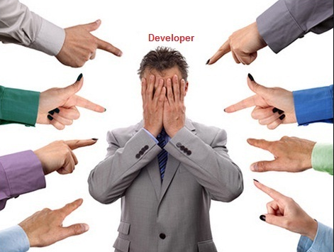
Issues…..with V2

Slide 5

Rollback ????

Slide 6
Without VCS
Once Saved, All the changes are permanent and can’t revert.
No Info on who updated what
Release Failure
Downtime of Application

Slide 7


With VCS

Slide 8
What is VCS…. ?
Version control systems are a category of software tools that help a software team manage changes to source code over time.
Version control software keeps track of every modification to the code in a special kind of database. If a mistake is made, developers can turn back the clock and compare earlier versions of the code to help fix the mistake while minimizing disruption to all team members.

Slide 9

Local….
The practice of having the CODE saved
in the local PC
Local DB keeps a record of the changes.
SCCS & RCS

Slide 10
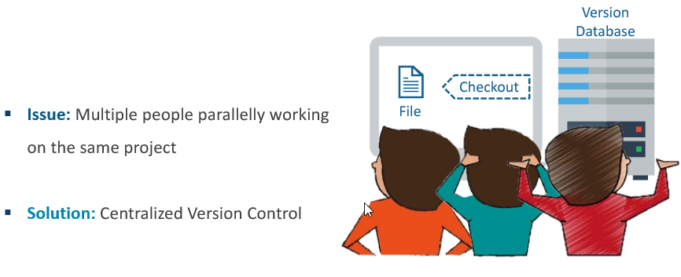
Problem ??

Slide 11
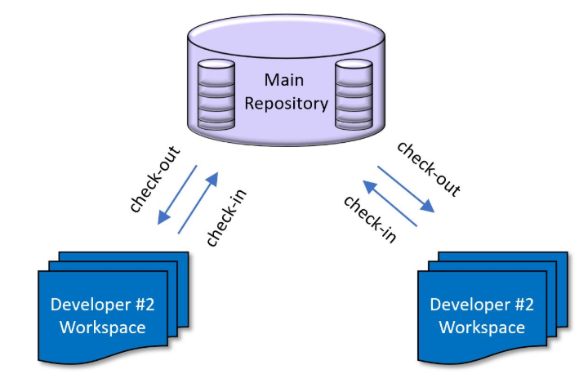
Centralized VCS
In CVC, A Central Repo is maintained where all the versioned files are kept.
Developers can checkout and check-in changes from their own computers.

Slide 12
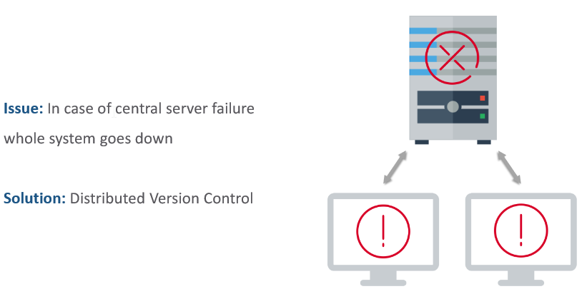
Problem ??

Slide 13
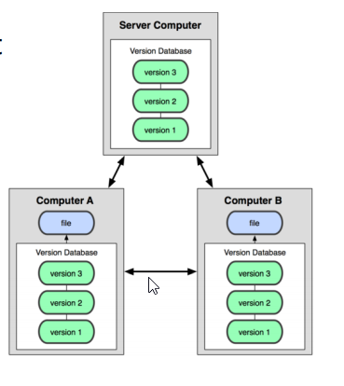
Distributed VCS
Version database (CODE) is stored on every Developer’s
local system and remote server
Changes are made is Local and then PUSH to server
Highly Available

Slide 14
History
First Generation
Single-file
No networking
e.g. SCCS, RCS
Second Generation
Multi-file
Centralized
e.g. CVS, VSS, SVN, TFS, Perforce
Third Generation
Changesets
Distributed
e.g. Git, Hg, Bazaar, BitKeeper

Slide 15
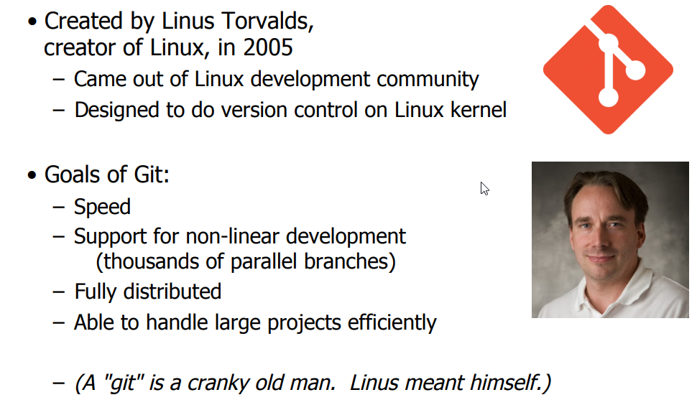
GIT

Slide 16
Let us Install !!
git –-version → See if it is already Installed
apt-get update (ubuntu) or yum update (rhel , centos)
apt-get install git or yum install git

